Slide 1
Ams Bootcamp
AMS Fest
Summer 2025

Slide 2

Exercise: Our Main Concern Is…
  WORD WALL (Post-Its)
  What are your system concerns?
  What are your vendor concerns?
  I want to make sure we cover….
  What is your confidence level?

Slide 3
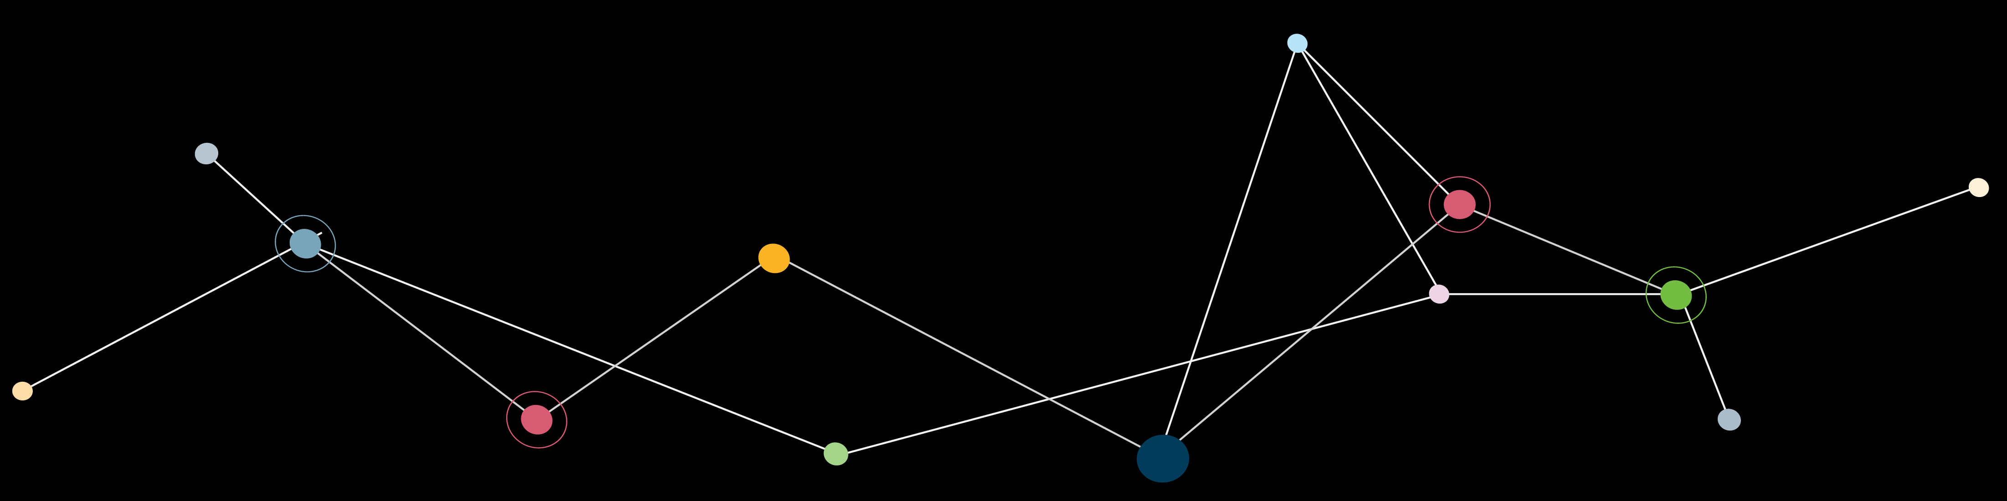


INTRODUCTIONS: technology guides
Gretchen Steenstra
Garrett’s Addict
Niko Cribb
Foodie

Slide 4


delcor SNAPSHOT
501(C) COMMITMENT | 35+ YEARS IN BUSINESS | 90+ FULL-TIME STAFF | 40+ DIFFERENT CERTIFICATIONS | VENDOR-AGNOSTIC CONSULTING

Slide 5
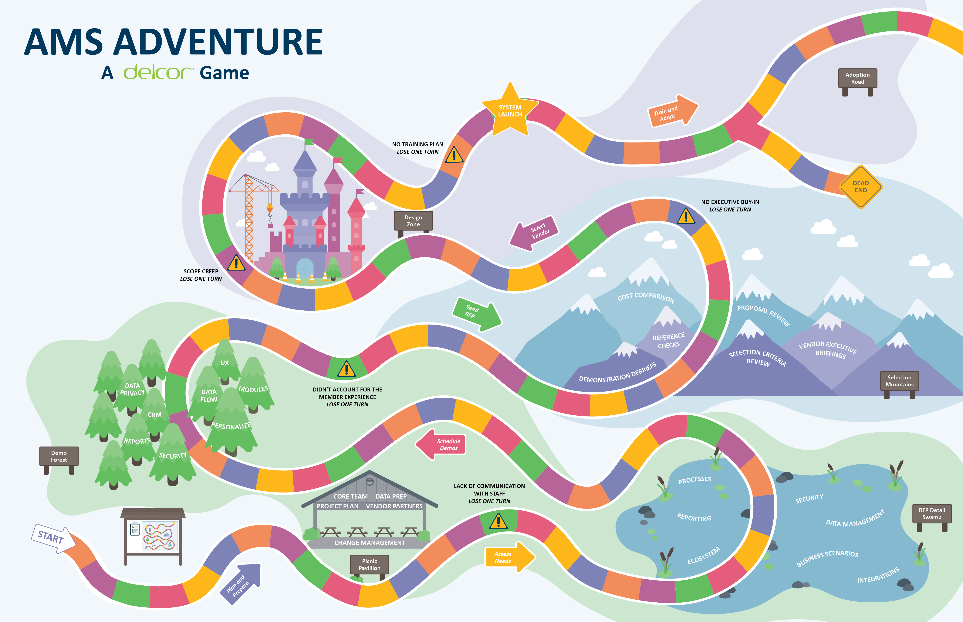

Slide 6
Agenda
Manage the Change for People
  Establish a foundation for change
System Selection 101
  Essential Selection Steps: What is critical vs. nice to have?
  Tools: Discuss and test tools to help develop the selection documents (charter, RFP, review, etc.)
System Selection Details
  Business Processes: What do you need to consider, define, and adjust NOW versus during the Implementation Phase?
  Requirements: Review several approaches to develop and share business requirements
  Selection Decisions: How do you evaluate RFPs, compare prices, and select a vendor?
  Contracts: What should associations consider to augment the legal review?
  Requirements Speed Round

Slide 7
Change Management

Slide 8
WHY DO BIG TECH IMPLEMENTATIONS FAIL?
Source: ISM Survey – US (CRM Implementations)
People
Process
Tech
50%
30%
20%
People
Process
Technology
Most Implementations
Successful Implementations
Notes:
Think about the big tech projects you have been involved in – Is 80% of effort focused on people and process?

Slide 9
Change Control vs. Change management
Change control is the decision to make a change, whereas change management refers to the aftermath of that decision.
Change management = [change control] + communication + training + adoption

Slide 10

Adoption – Start Planning
System Change -> Work Change
Identify Major Changes now
  System
  Staff Process
  Member Expectations
Training
  What can you learn now?
Notes:
Create a process to make decisions
Staff and members WILL be:
Annoyed, frustrated, scared, nervous, and EXCITED!
Plan for mistakes with the vendor
Some changes look good on paper, but they don’t work
You will learn and processes will evolve, so plan for it

Slide 11
AMS, CRM or ??

Slide 12
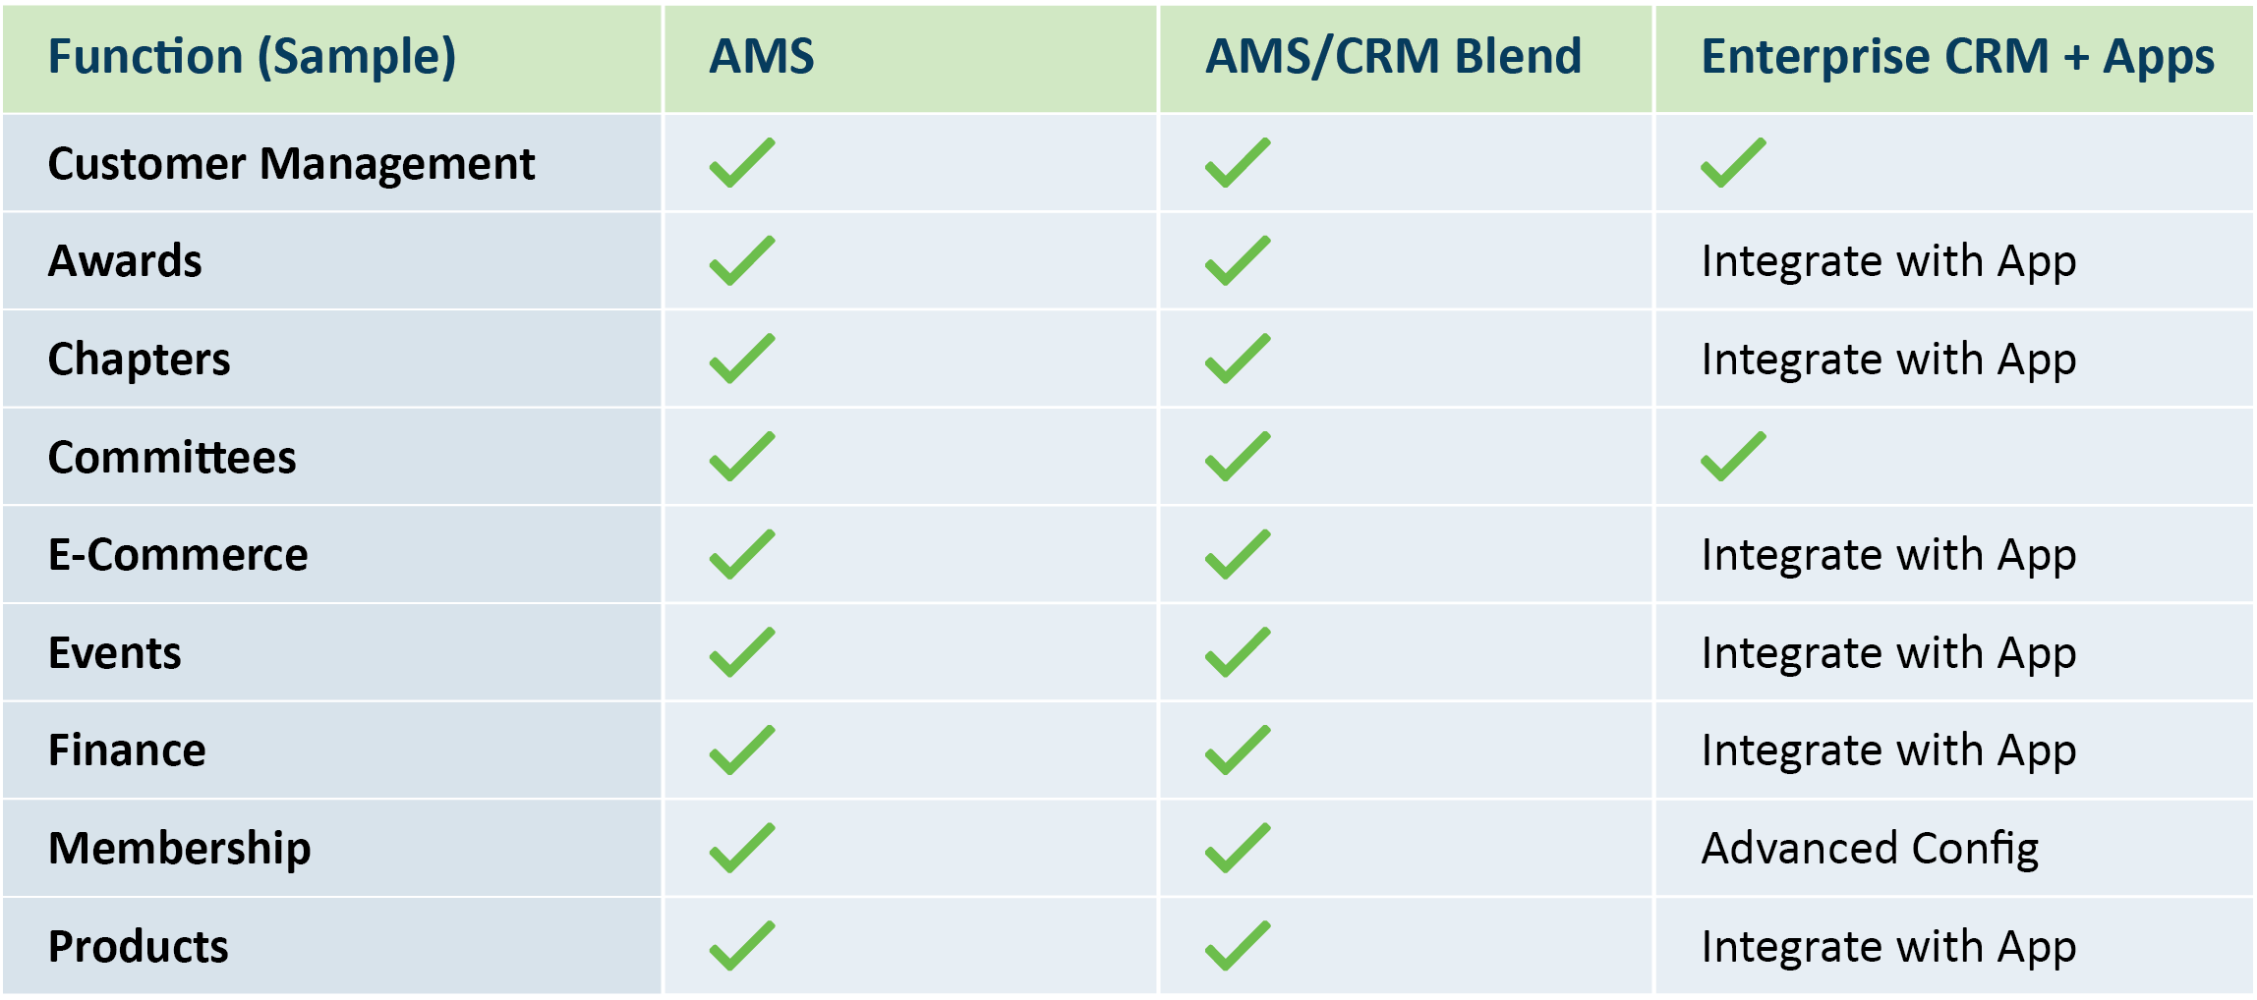
AMS Vs CRM
Notes:
Graphic – AMS vs CRM
-Add Meatball Chart from Blog
CRM+AMS, AMS or Enterprise CRM
How do you know what you need?

Slide 13

Relationships: system, vendor, and Association
Client Config
CMS
Partner AMS Layer
Event-MS
Integrations
Association Technology Ecosystem
Platform
Core
Data Analytics
FMS
LMS
Notes:
The AMS System will integrate with relevant association systems
AMS Platform Core: SQL, Salesforce, Microsoft, Oracle
AMS Layer: (owned & managed by AMS company)
Relationship with Partner systems: (website interface, integration)

Slide 14

Risk: All in 1 or diversify – make a slide of pro/con
Major Functionality Missing from Demo
Simple Functionality Missing (Low Risk, Low Volume)
Required Functionality is Not Offered by the Vendor
STAY OR GO?
Notes:
Graphic – AMS vs CRM
-Add Meatball Chart from Blog
CRM+AMS, AMS or Enterprise CRM
How do you know what you need?

Slide 15
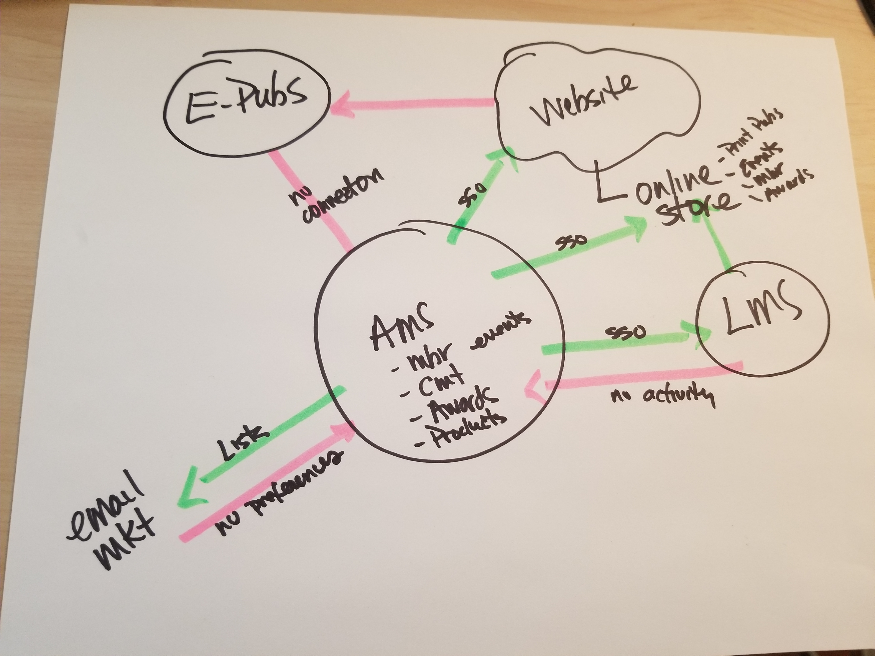
Ecosystem: Draw your Ecosystem (screen break)
Include if:
Revenue
Member benefit (real one)
Support future growth
OTHERWISE
-Leave it behind or integrate
Notes:
Take this with you and share with vendors. Some info many need to come out.
What is core and what is extra

Slide 16
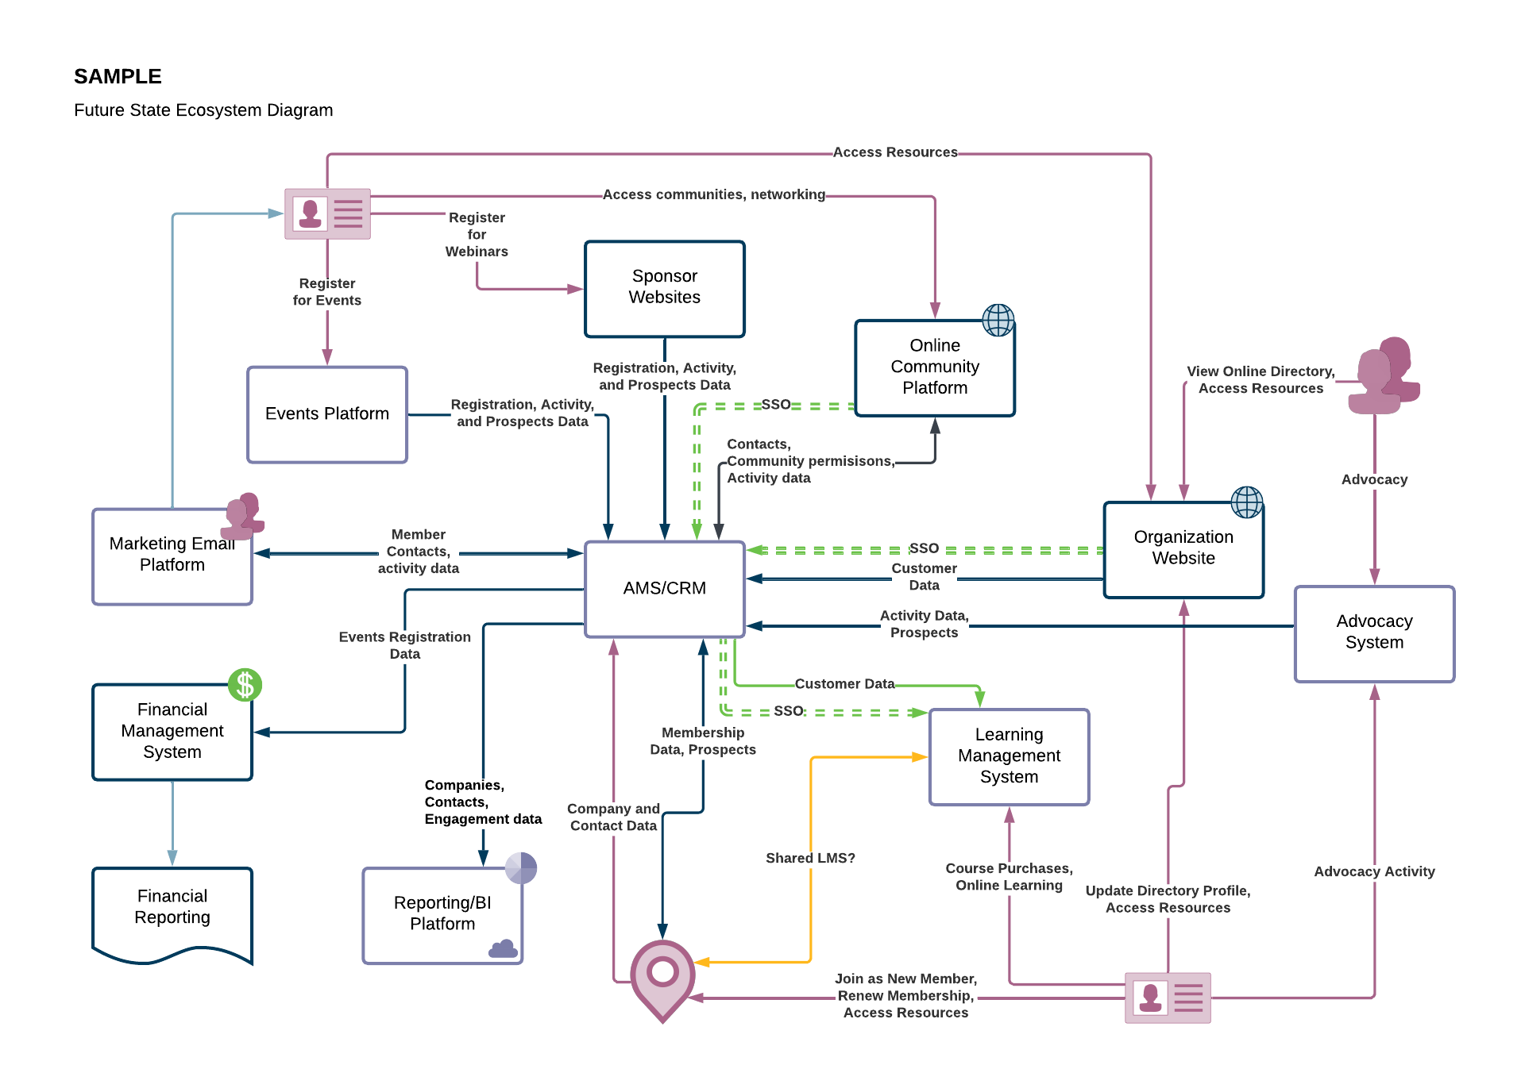
YOu need THIS!

Slide 18

poll
How long should the selection take?
1-3 months
3-6 months
6-9 months
12+ months

Slide 19
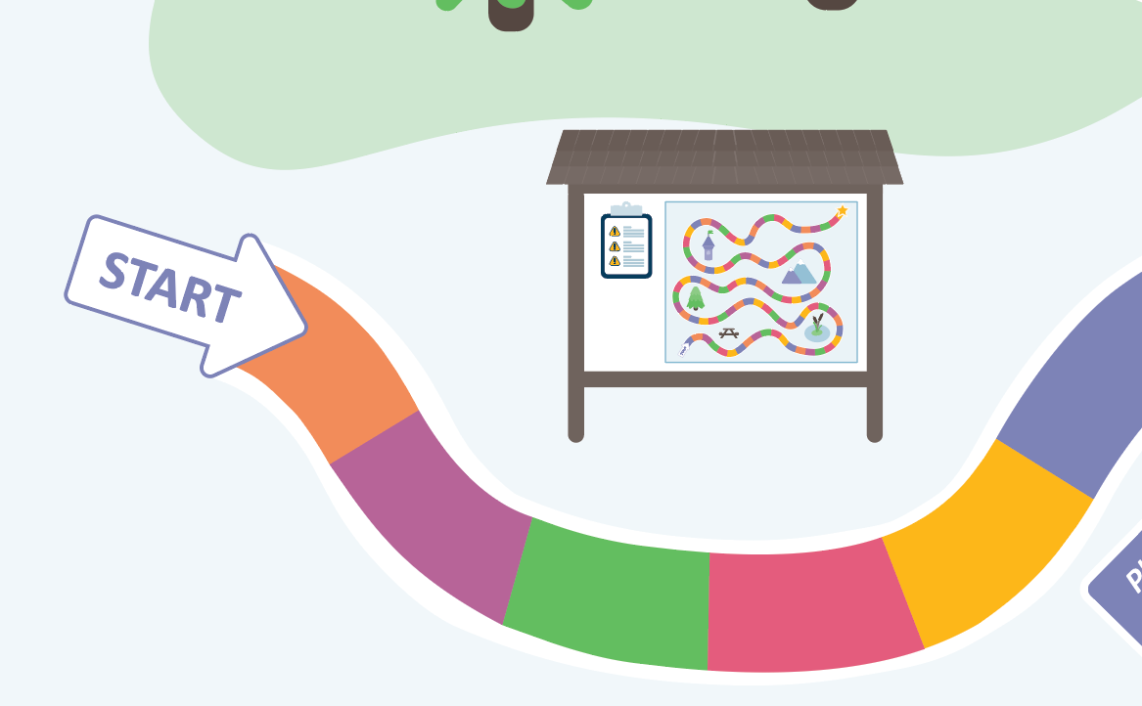
Selection "START"

Slide 20


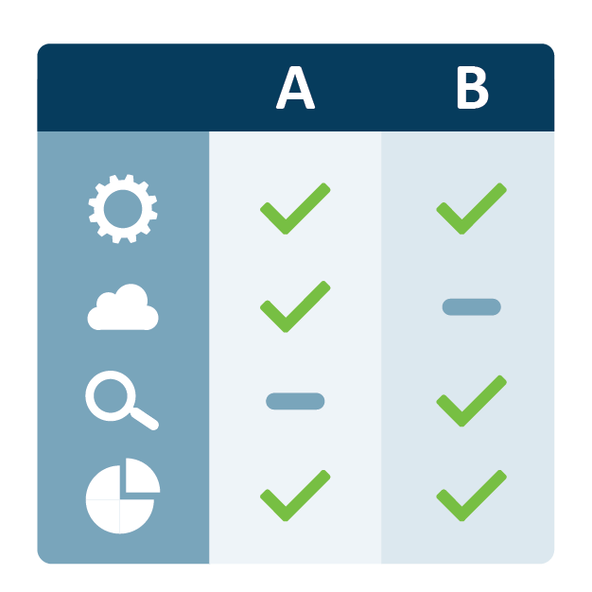
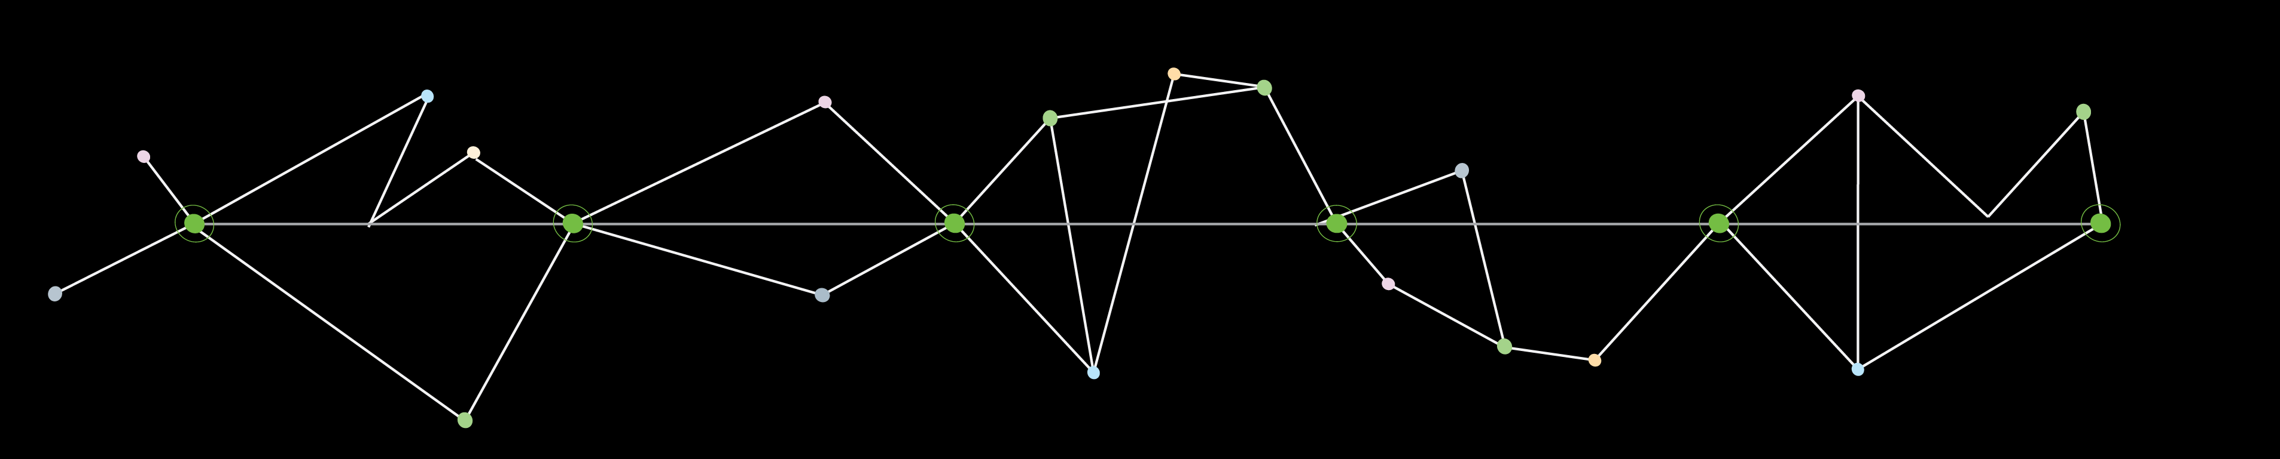


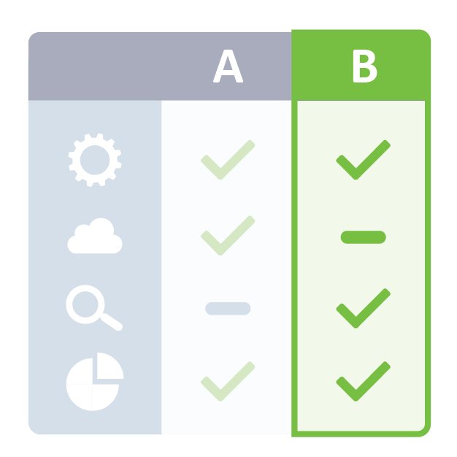
System Selection Phases
Kickoff Meeting
RFP
Decision Process
Charter
Demo
Make a Decision

Slide 21

Core team - Selection
How many people should be on your core team? Do you have the following?
Decision Maker
Business Owners
Finance
Marketing/Communication
Customer Service

Slide 22
Selection Time Commitment
 |  |  | Staff Time Commitment
Phase | Timeframe | CLIENT Staff Task | Core Team | Stakeholders
I: Selection Planning and Initiation | 4-5 weeks | Prepare Background Information for Review | 2 hours
 |  | Participate in Initial Meeting | 2 hours
 |  | Participate in Project Kickoff Meeting | 1 hour | 1 hour
II: Discovery and RFP Development | 4-5 weeks | Participate in Discovery Meetings | 1-2 hours per relevant session | 1-2 hours per relevant session
 |  | Participate in Meeting to Discuss Vendors | 1 hour
 |  | Participate in Demonstrations (3) | 24 hours | 12-16 hours
 |  | Participate in Demonstration Debriefs | 3 hours | Optional
IV: Vendor Selection | 4-5 weeks | Participate in Discussion to Identify Finalists | 1 hour
 |  | Review Proposals (2) | 2 hours min.
 |  | Participate in Final Vendor Selection Discussions | 4 hours
V: Contract Negotiations | 3-4 weeks | Participate in Contract Negotiations | TBD
VI: Implementation Planning and Initiation | TBD | Review Implementation Transition Plan | 1 hour
 |  | Participate in Vendor Discovery Preparation | 4-8 hours
 |  | Attend Vendor Discovery Meetings | TBD
VII: Implementation Project Management | TBD | Participate in System Implementation with Vendor | TBD | TBD

Slide 23
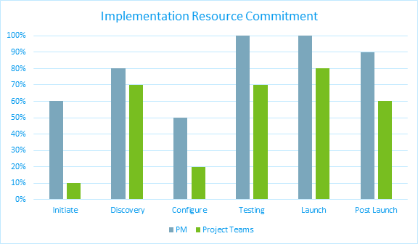
Roles and Resources – Implementation – Plan Ahead

Slide 24
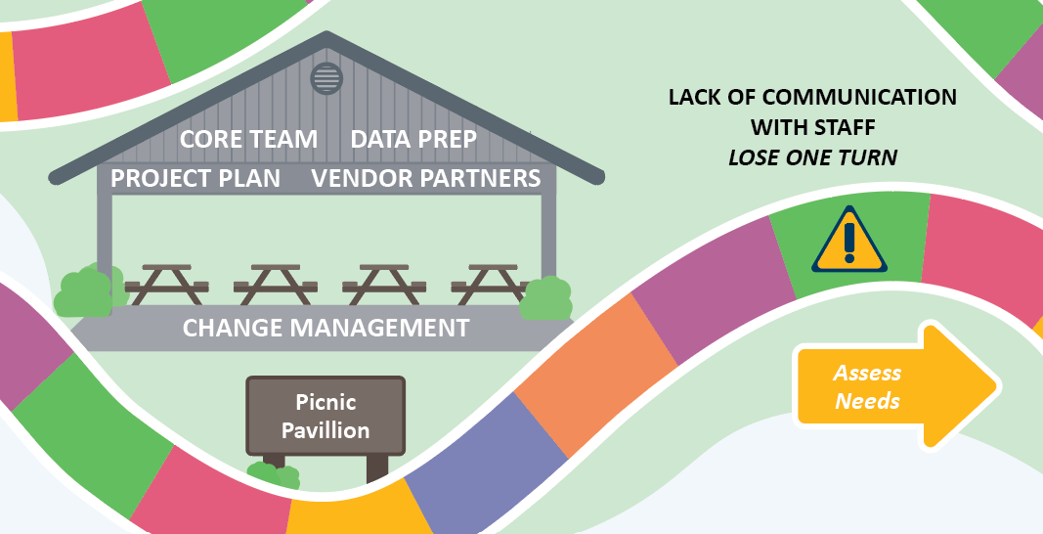
Lack of Communication
Lose a turn!

Slide 25
Communication: internal and external
Internal
  Updates of milestones and progress
  Project Team, Staff, Leadership/Board
External
  Updates to leaders and members
  Keep Vendor Partners informed
  ‘Coming soon – new registration process’
  Ask members to provide feedback
Notes:
Be careful about dates
-setting dates that may change a lot can lead to confusion, disruption
-Start with a milestone, then narrow to a date
-consider a soft launch
Tailor communication
-if member have a BIG impact from the change, personalize info (e.g. certification process is changing – let people KNOW. And more than 1 time.

Slide 26
Project Charter
5 W’s (Who, What, Where, When, Why)
Why are you starting to look?
Why now?
What is your pitch?
If you can’t state your goal right now, you may not be ready
Association focus on WHAT and WHY
Vendor focus on HOW?
Notes:
Purpose/Objectives
Alignment with Strategic Plan
Acceptance criteria
In/out of scope
Deliverables
Resources
Budget

Slide 27
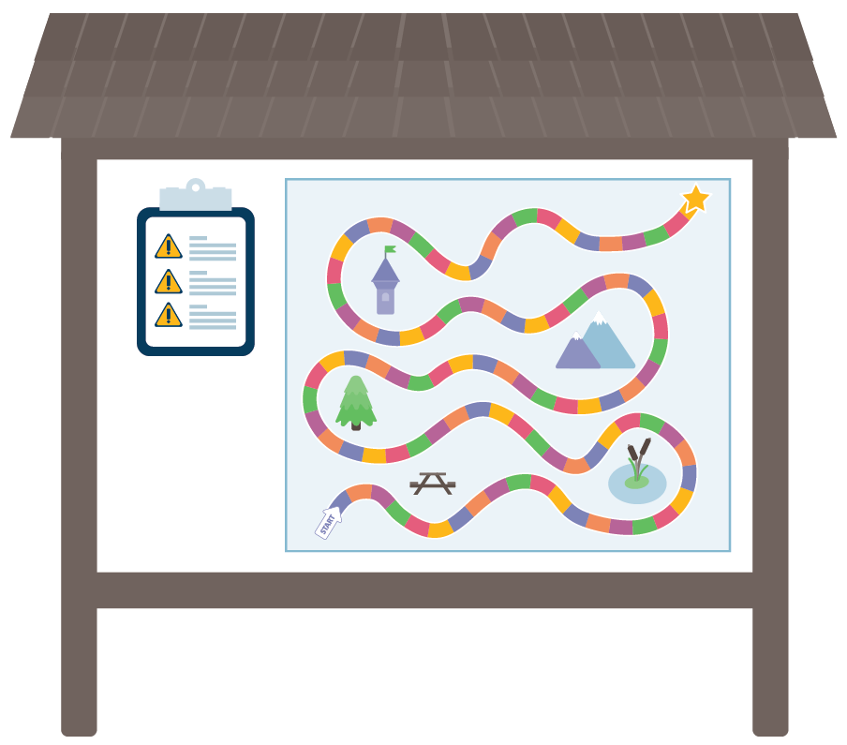
Discovery Trailhead

Slide 28
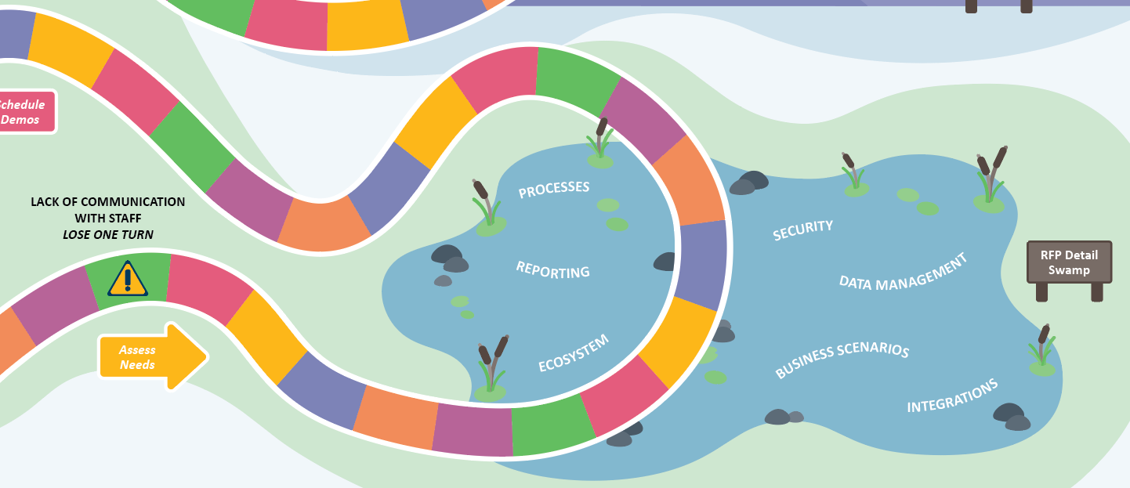
SECTION BREAK: RFP SWAMP

Slide 29
Why a request for proposal (RFP)?
Use the RFP to organize your needs and state your goals.
Focus on your business needs (What and Why – not How)
Align association goals and business functions
Refresh and improve processes
CLARITY (check the box)
Same info from each vendor

Slide 30
RFP are a guide for vendors
Clear Business Goals
Revenue-driving functionality – add details!
Unique configuration or custom apps that need to be replaced
Scope for initial project
Tolerance for future deliveries and smaller projects

Slide 31
Where do you find requirements?
Standard Operating Procedures (SOP)
Tribal
Knowledge
Organizational
Goals
Member/Customer
Needs and Processes
Staff Needs and Processes
Notes:
BOTH
Where do requirements come from?
SOP
Tribal knowledge
Goals of the organization
Member/Customer Needs and processes
Staff Needs and processes

Slide 32
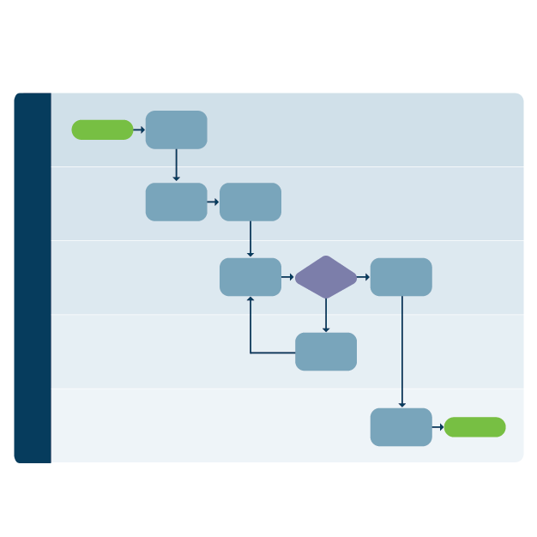
Business and Processes: Just enough detail
BUSINESS processes
VS
business PROCESSES
Notes:
Fine line of too much info
-vendor’s don’t read it
BUSINESS – during selection, focus on the why and what
PROCESS – during implementation unpack the details of the process and HOW with the vendor

Slide 33
Tell your story (what and why)
Find the best way to tell your story
Break it down into requirements – focus on what vs how
Specific
Testable
Relevant
Traceable
Complete
Verifiable
Concise
Functional Requirements (System Behaviors)
Non-Functional Requirements (System Performance)
Notes:
BOTH
E.g. discuss how money flows
Requirements: Proration, Deferral

Slide 34
Create a user story
User stories:
Are a way to simplify requirements.
Expose the detailed requirements.
Highlight the business reason for each functionality.
Are testable.
As a… | I want to… | So that… | Acceptance Criteria
Member | Renew Online | I can pay immediately with my credit card

Slide 35



Data: Requirements
What are you REALLY doing with your data?
What is the relationship between data and process?
Data conversion
Report inventory
Data standards
Data integration
Notes:
Disorganized data can make your ecosystem even more confusing
How can you clean it up and organize?

Slide 36
Review your requirement
Is it comparable?
Is it scorable?
Is it a single requirement/single answer (baseline Y or N)?
Can a stranger understand it?
Do you need to add context? Vendors don’t know all the facts about your ‘special’ process.

Slide 37
Identify areas of potential change
Use the selection process to identify business processes that may need to change
Difficult requirements
Areas that require customization
Processes that need the most customer service/TLC
Processes that support the most revenue
Processes that can be automated
Notes:
Change your process when you can – think about this NOW!
What is in the RFP that was flagged as a concern? What was hard to define?
Automation: Give the power back to the member – you do NOT NEED TO check every single record.
Use exception reports to identify problem data
No money – no mission
WHY is your refund process 5 steps with 2 check? Does this serve the member or create revenue?
WHY do you have 15 discounts? Does this serve the member or create revenue?

Slide 38

10 Min…GO!
Notes:
ACTIVITY: Document a business rule that you can share with your neighbor

Slide 39
Requirements Workshop
Write requirements for the case
    What and Why – not how
Rotate
Edit/Refine
Review
Signal Words: Ask More Questions
Intuitive
Simple, user friendly, easy
Integrated
DIY
Training and documentation
User
Design
Notes:
Case 1
Financial – Automate Refund Process
Your organization has a manual process to manage refunds
Customers email request or staff email finance. 2. Finance reviews request and processes refund)
Move to a workflow where customers can request a refund online. Workflow sends request to finance>process refund>alert to customer service>auto email to customer
Case 2
Membership – Students to Regular
Your organization is developing a new program to support new members
System must monitor the graduation date and renew a customer to regular after graduation date
? What is the renewal business rules?
Onboarding process to recommend learning and industry groups
?What are business rules to recommend services
?What is communication process
?What are integration ideas (website, emai lmarketing)

Slide 40
Finalize RFP

Slide 41
Pull it together to Build the RFP
Checklist:
Introduce the project
Background of your organization
Project goals and scope
Business objectives
Overview of functional areas
Ecosystem Current and Future
Specific questions and needs (e.g., requirement)
Instructions to vendors
Notes:
Do you make major purchases at home with out a list? Buying a house, car, college for kids?
Don’t ASSUME the vendor took amazing notes during your sales calls and demos
Don’t ASSUME any new system will fit YOU?
Instructions for vendors:
Procurement schedule
Duration of the proposal (how long is it valid)
Cost of proposal prep
Vendor evaluation criteria

Slide 42
RFP: Add ecosystem diagrams – focus on the future

Slide 43
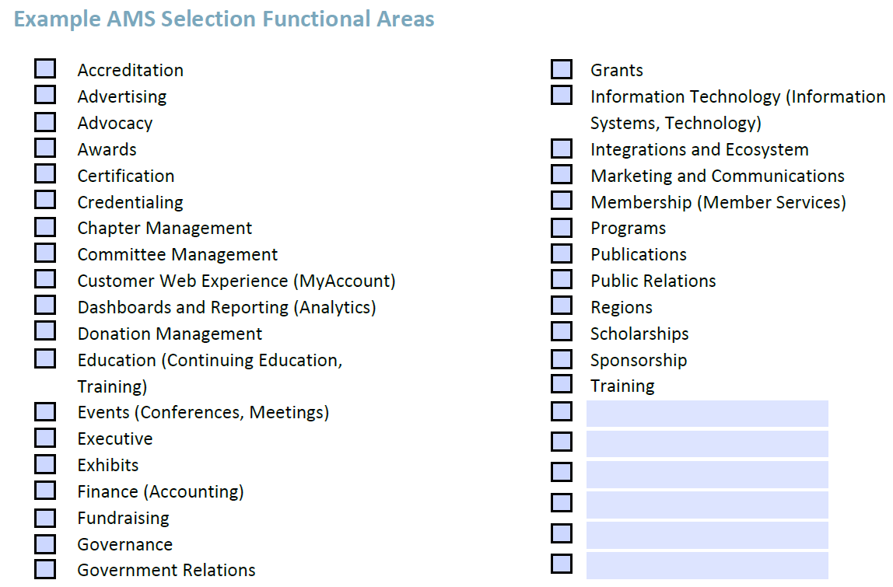
RFP: focus on the Functions

Slide 44


Release the RFP?
True
False
Notes:
Never buy an AMS without visual and written info
Pro/con of RfI, RFP and straight to proposal

Slide 45
poll
How many vendors should I consider?
8
2
5
3
All of the above (18)

Slide 46
Vendors: Talk to them!
Tell vendors what you need and then make them prove they can do it!
Be honest
Provide an overview of your association
Discuss current AND future needs
Share general budget range
Share staff size and resources
Use your RFP as a guide
Notes:
Narrow the list
Share the schedule – especially if there is a mandatory launch date

Slide 47
Partners
Ask about Partner network – this is very helpful!
Experts leave application provider and start their own company
  Element, Plutus, Aplusify, Meto-Dao, Velosio, En-SYNC
  RSM, Fionta, fusionSpan, Wipfli
Implementation Services
Long Term Support

Slide 48




Selection Criteria: Highlights
Functional
Requirements
Platform and Services
Cost
Requirements
Vendor
Requirements
Customer-Facing
e-Commerce
Exports
Integrations
Partners
Licensing
Implementation
Notes:
Determine how the core team will evaluate vendors BEFORE the demos.
See handout
Selection criteria should include information from the demos and the proposal

Slide 49
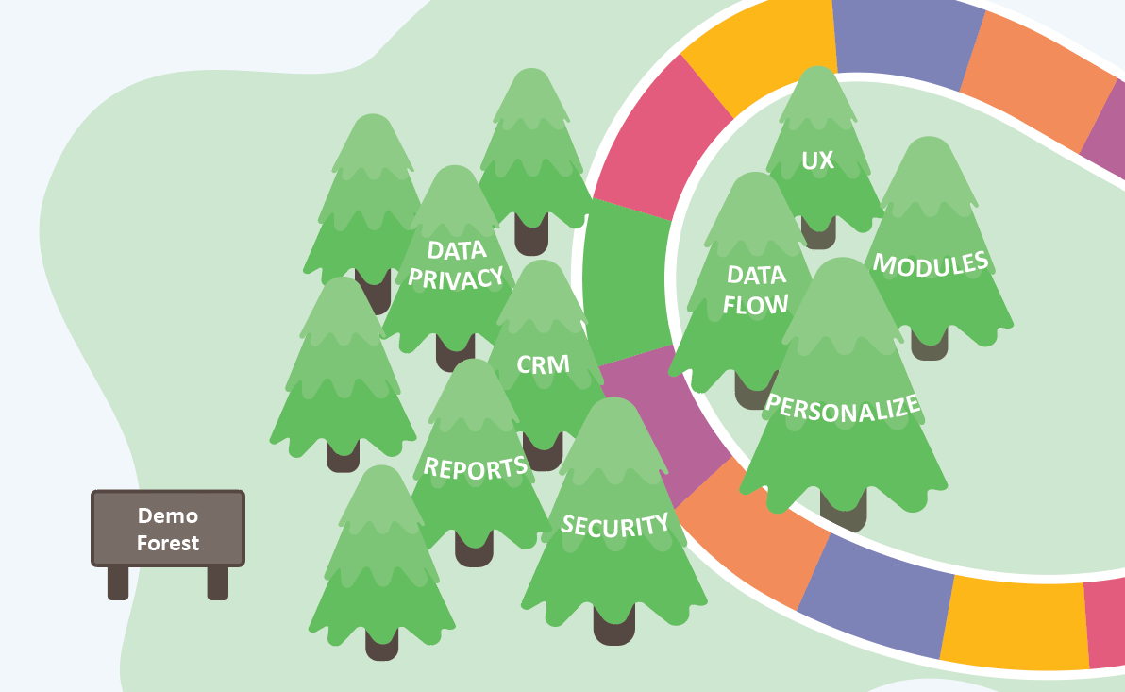
Section Break: Demo Forest

Slide 50
Demos: Preparation
Provide Vendors
  General agenda and outline
  Business scenarios (tell the story of a set of requirements, describe critical, complex processes – bulk dues, group registration, chapter management)
  Sample event and registration form
  Draft RFP (for additional reference)
Decide your process to evaluate vendors

Slide 51

Demos: Agenda topics
Introduction
Navigation
Customer Management and Experience
Membership
Finance
Query/Reports
IT/Platform
Notes:
*Customer experience should be discussed throughout the demo

Slide 52
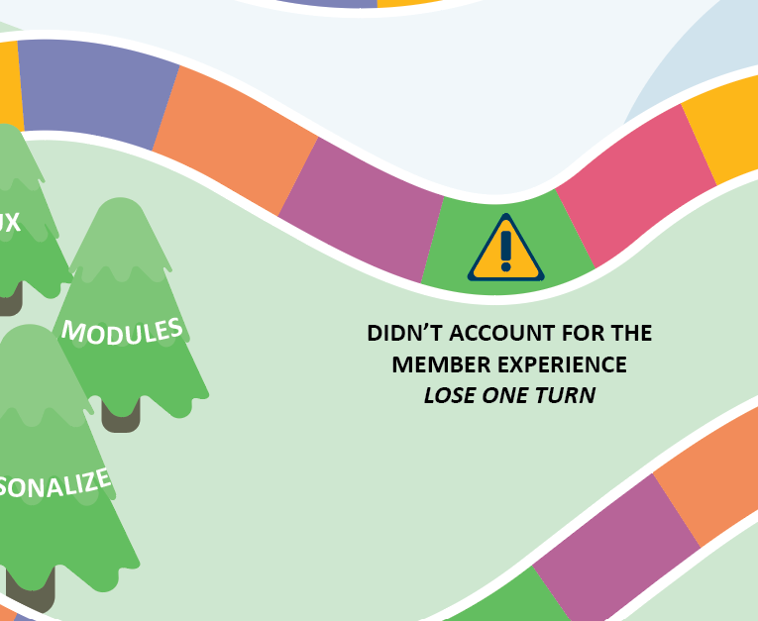
Didn’t account for member Experience!
Lose a turn!
Notes:
This is a SELECTION, so what is needed to SELECT a system?
Focus on must haves and deal breakers
Highlight functionality that is missing from the current system
Identify features you need to maintain (e.g., certification, group registration)
Identify what your members/customers need

Slide 53
Demos: In-person vs virtual
In-Person
Virtual
One full day to cover critical topics
Follow-up demos as needed
One full day with a break
Two half-day demos (either back-to-back or by topic)
AVOID too many short meetings – you need time to focus

Slide 54
Demos: tips for virtual demos
Pre-Test: Ask vendors to join 15 minutes early to test access
Record: Will vendors allow you to record and share?
Ground Rules:
  Identify a staff member to manage the schedule and give a 10-minute notice before a section’s ending time
  Once demo begins, staff will mute and turn off their camera to focus on the demo (okay for vendors to do same)
  Use virtual chat feature to submit questions for vendor

Slide 55
Evaluating DEmos
Don’t get distracted in notes. Focus on performance of key scenarios.
Create a ‘Scoring Sheet’ for Staff
Debrief Immediately
KISS
Survey after each demo
Focus on differentiating factors
  E.g. customer experience, reporting, workflow tools, number of clicks
Score the vendor and submit right after the demo
Identify follow-up
Decide to keep or reject (remember that this is a SELECTION)

Slide 56
Should I Include staff feedback that’s incomplete?
Yes
No
Notes:
BOTH
If staff do not create good notes/official score – do NOT include data in the full evaluation
If a staff member does not attend ALL sessions – do NOT include data in the full evaluation

Slide 57

Can you eliminate 1 vendor?
Don’t forget, this is a selection to identify one vendor.
It’s easier to compare two proposals, so consider eliminating a vendor after demos.

Slide 58

Send RFP – ASK for a Proposal

Slide 59
Release the RFP and then….
Update selection criteria
Define reference questions

Slide 60
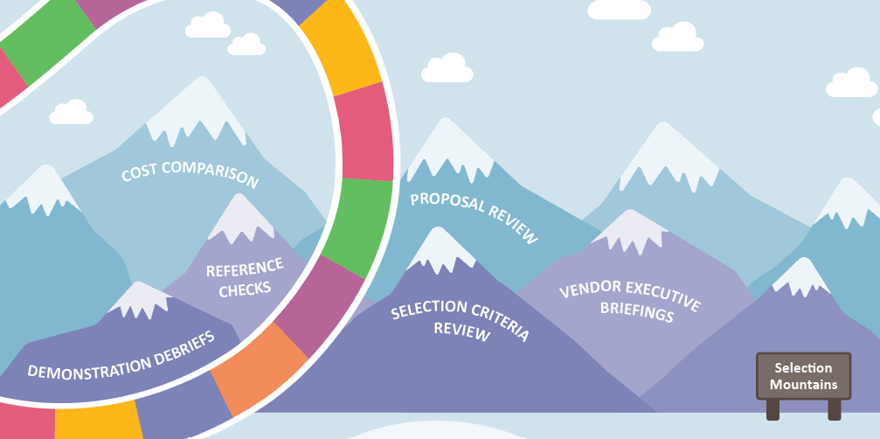
Selection MountaiNS

Slide 61
Proposal Package
Master Services Agreement (MSA)
Vendor Overview
Response to Requirements
  Written
  Excel List
Proposal Cost ‘Investment’
  Licensing, Hosting
  Implementation

Slide 62
Scoring the proposals
Don’t make this too hard – focus on key elements that are essential
Reference Check Feedback
System Functionality
Vendor Implementation Approach
Vendor Resources
Cost
Member and Staff Experiences
Notes:
TALK ABOUT REFERENCE CHECK

Slide 63
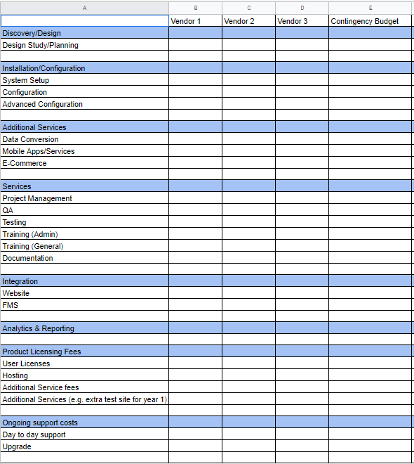
Handout: Compare Vendors (cost and functionality)

Slide 64
budget
ALWAYS have a contingency plan: 20% minimum (don’t tell PMI)
What is a good budget?
What partner systems are you considering?
1% of IT budget
$ per staff person
Implementation (one time)
Recurring Costs (licensing & environment)
Event, Exhibit
DelCor Blog

Slide 65
Decision
Functionality
Price
Intangibles
Best Choice

Slide 66
It’s okay to select the system you like
Systems in the same class are similar
What system can you SEE yourself using?
Did it make sense during the demo?
Make a choice

Slide 67
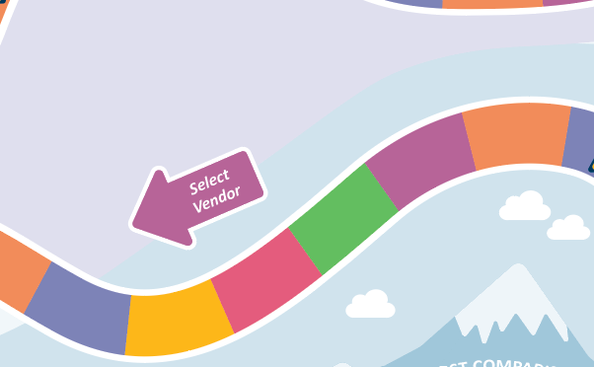
Decision Time!

Slide 68


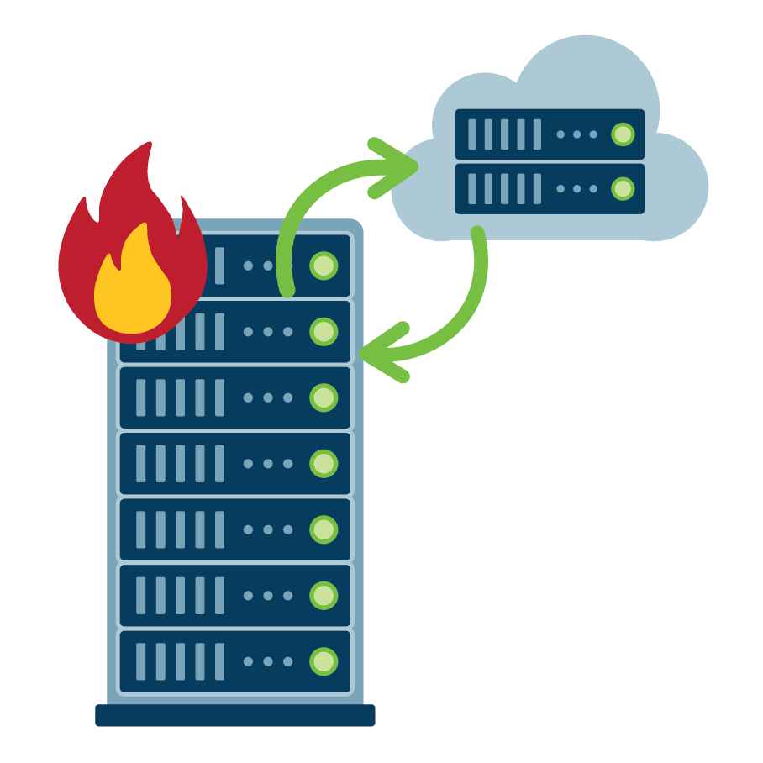


Contract (MSA and SOW)
Legal
Work Together
Data Security
Insurance
Intellectual Property
Service Level Agreement
Termination
Warranty...
Acceptance
Deliverables
Exit Strategy
Fees/Payments
Project Management
Testing...

Slide 69

Remember… there’s no magic wand!
Envision how the AMS fits within your data ecosystem (beholder of all data or piece of the pie)
Define what success looks like to your organization post-launch
Set realistic expectations for your staff and volunteers

Slide 70
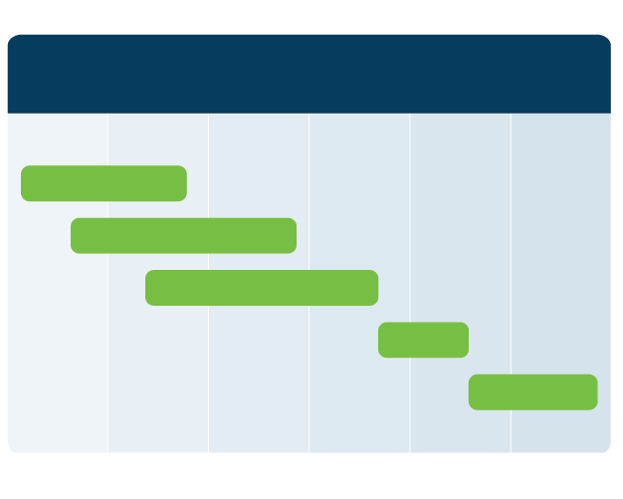

What’s next?
Partner
Plan
Schedule
Start
Choose the partner that is the best fit for your organization.
Review staff calendars and plan for the selection process.
Schedule the project kickoff and discovery meetings.
Get started! There’s never going to be a better time to start.

Slide 71
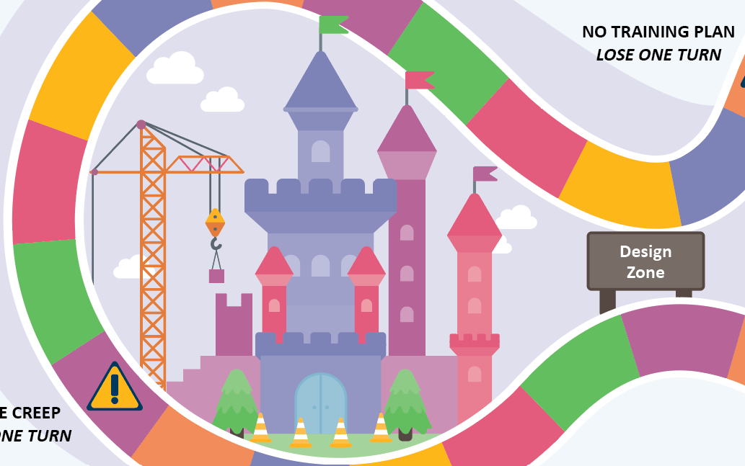
Adoption Castle

Slide 72
Non-Technical Changes>Impact
New Manual Process
Loss or change of functionality
More configuration and workflow options
Fewer configuration and workflow options

Slide 73
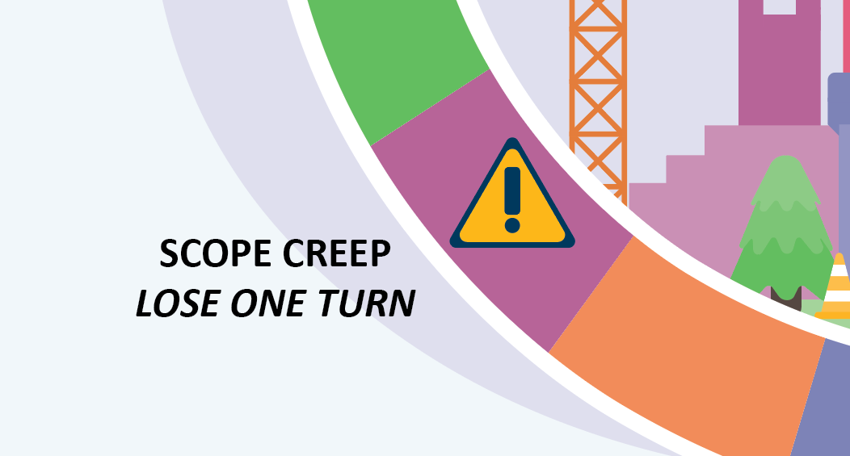
Lose a Turn!

Slide 74
What areas can you address RIGHT NOW?
Notes:
Wrangle defined as: Argue, dispute, quarrel, battle, squabble, disagree
-data conversion
-report inventory
-data standards
-data integration

Slide 75
What’s next?
Plan
Identify System
Schedule
Start
Identify your goals and align with your association’s strategy
Create a business system ecosystem map
Start small and build – this does not have to happen all at once
Get started! There’s never going to be a better time to start.
Notes:
Data Governance 101?

Slide 76

Preparation
Data Inventory
  Source
  Type of data (customer, invoice, demographics)
  Purpose
  Quality
  Will it convert?

Slide 77
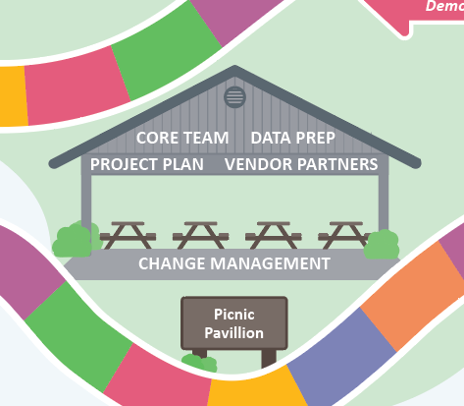
Implementation Planning

Slide 78
Core Team Tasks
Reset Core Team
  Update roles for each implementation phase (discovery, configuration, testing, launch, post-launch adoption)
  Confirm executive sponsor
Establish feedback process
Establish change management process
Confirm roles at each stage of the project

Slide 79
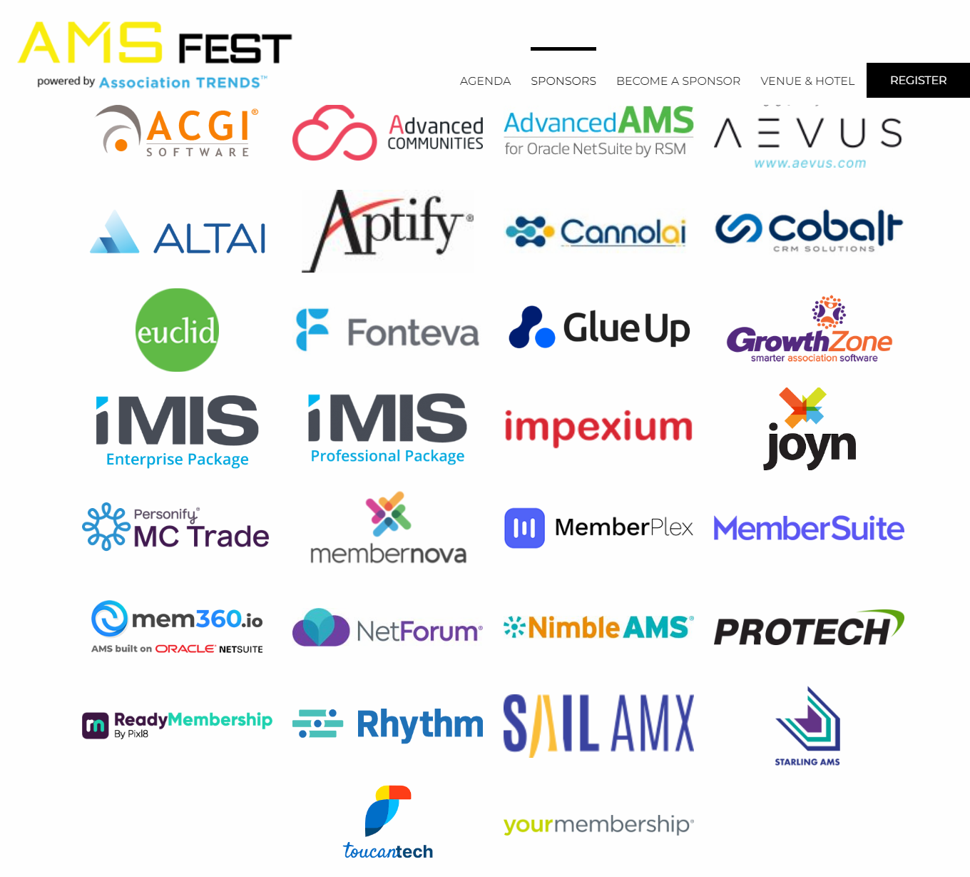
Vendors you should visit at AMS Fest? UPDATE

Slide 80
Implementation Planning
Extra docs

Slide 81
communication: Stakeholder Analysis (FLIPCHART)
Dry Run for Selection – Critical During Implementation
Power
Keep Satisfied
Manage Closely
Monitor
Keep Informed
Interest
Notes:
Update this with EACH STAGE – this will shift around launch. (WRITE THIS OUT)
Sticker
Red: CEO
Green: CFO
Yellow: CMO (Marketing/Communication)
Blue: Customer Service

Slide 82
Communication: raci can Make or Break
Responsible
Accountable
Consulted
Informed
Carries out the process or task assignment
Responsible to get the job done
Accountable for the process or task being completed appropriately
Responsible person(s) are accountable to this person
Not directly involved with carrying out the task, but are consulted
May be a stakeholder or a subject matter expert
Receive output from the process or task, or those who have a need to stay informed

Slide 83
Communication: RacI Example
The discussion of roles is as important as the chart. Only 1 A (Accountable)
RACI Matrix
Task | Project Manager | Business Analyst | Technical | Development | Finance | Executive
Project Planning | A | I | C | C | C | C
Project Initiation | A | I | I | I | I | I
Project Charter | A | I | C | C | I | I
Stakeholder Analysis | A | C | C | C | I | I
Develop Use Cases | A | R | R | R | R | R
Participate in Demos | A | R | R | R | R | R
Notes:
Something I (and a couple of other DelCorians do) is use the A for "approver" so PM is responsible but someone else might have to approve the decision. This helps alot for when you're deciding on requirements, costs, various functionality needed for different business areas but that is a different RACI with business areas being the task), not sure if we should add another one?

Slide 84
Vendor Discovery
Yes, information will be covered AGAIN!
Vendor review requirements and add details
  Focus on your business OUTCOMES are validation requirements
RFP will be replaced by vendor implementation plan
  CROSS CHECK carefully!

Slide 85
Impact Analysis – Add additional information to Vendor Docs
What is changing?
Process today
What do you want to happen – future?
What policies, processes are needed?
System, Workflow, Outputs, Communication
Who is involved?
Business Owner, Finance, IT, HR, Partners
Separate system change and internal processes changes
Notes:
Phase 2: Update impact after vendor responses
Identify what is part of the project and staff role to manage

Slide 86
Change Management Roles and Responsibilities
Role | Responsibility
Change Team | Facilitate key functional configuration decision-making. Obtain buy-in from business areas. Manage customer experience and integrations with website partners. Ensure change management initiatives are implemented (e.g., policy changes, external/member communications).
Project Change Manager | Involve leaders by conducting leadership workshops. Identify key stakeholders, complete a change impact assessment, and determine communication and engagement needs. Coordinate with training delivery teams to develop/deliver training. Engage with the Change Team.
Change Management Sponsor | Executive team member who is accountable and responsible for the overall project.

Slide 87
Sample WOrkflow

Slide 88
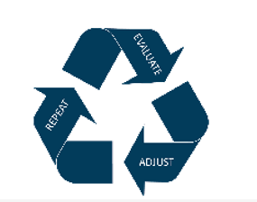
reinforcement
Plan for Adoption NOW
Develop Training Plan
  Onboarding new staff
  Launch Training
  Advanced Training
  AMS +
    SF Trailhead, Dynamics CRM, Power BI, Automation tools
Examine, Repeat, Adjust

Slide 89



resources
ASAE AMS Resources/ASAE Collaborate
Consultants
AMS Fest
Review My AMS
DelCor AMS Selection
DelCor AMS Fest Resources

Slide 90






Contact us
877-4DELCOR
@delcortech
301.585.4222
@delcortech
@delcortech
DelCor Technology Solutions
@delcor

